Slide 1





Introduce Geocomputation with R
Season1:
Unlocking Geocomputation: An Introduction to Spatial Analysis with R
by: Dina Yazdani

Slide 2


Table of Contents
1- Geocomputation with R
*Target Audience
*Benefits of R
2- Book Structure
3- Learning Approach
4- What is Geocomputation?
*Definition
*History
5- Open Source Tools for Geocomputation
*Evolution of Geographic Tools
*Advantages of Open Source Tools
6- Why R for Geocomputation?
*Role of R
*Advantages Over Other Languages
*Revolutionizing GIS
* User-Friendly Interfaces
* Flexibility
7- Key Strengths of R for Geocomputation
*Reproducibility and Ease of Use
*Interactive Mapping
*R-Spatial Stack
*Publication-Ready Outputs

Slide 3
Table of Contents
8-Comparing R with Other Languages
9-Key Advantages of R over Python
* Superior Geographic Raster Data Support
*Statistics and Spatial Modeling
*Reproducible Data Science Ecosystem

Slide 4
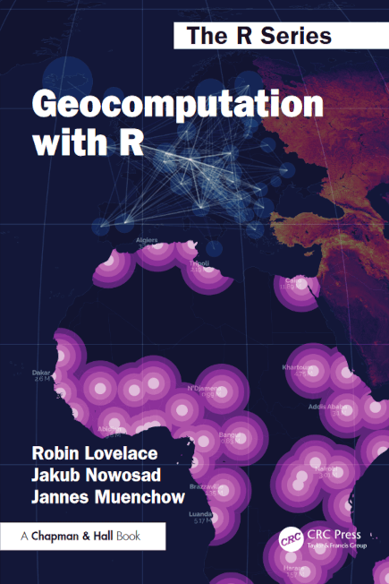

Geocomputation with R

Slide 5
Geocomputation with R
"Geocomputation with R" is a comprehensive guide for anyone wanting to analyze, visualize, and model geographic data using the powerful, open-source R programming language. It bridges the gap between traditional GIS software and command-line geocomputation, offering a flexible and reproducible approach.
Target Audience:
*GIS users wanting command-line power.
*Graduate students and researchers in geography, remote sensing, and related fields.
*Professionals needing spatial analysis in various sectors (urban planning, logistics, etc.)
Benefits of R:
*Powerful (geo)statistical and visualization capabilities.
*Reproducible workflows (sharing scripts).
*Flexibility and speed compared to point-and-click GIS.
*Strong in data science and big data applications.

Slide 6

Book Structure:
Part I: Foundations (getting started with spatial data in R).
Part II: Advanced techniques (visualization, programming, statistical learning).
Part III: Real-world applications (transportation, geomarketing, ecology).
Learning Approach:
Progressive learning with exercises and solutions.
Emphasis on practical examples and reproducible code.
Resources for R beginners.

Slide 7
Attribute | Desktop GIS (GUI) | R
Home disciplines | Geography | Computing, Statistics
Software focus | Graphical User Interface | Command line
Reproducibility | Minimal | Maximal
Differences in emphasis between software packages (Graphical User Interface (GUI) of Geographic Information Systems (GIS) and R)

Slide 8
What is Geocomputation?
Definition:
Geocomputation involves using geographic data to solve problems, with a focus on:
-Reproducibility
-Flexibility
-Tool Development
History:
-First introduced at a conference in 1996.
-Unlike early “Quantitative Geography,” geocomputation emphasizes creative and experimental methods alongside new tools.
-Stan Openshaw defined geocomputation as creating tools and methods within a scientific framework.

Slide 9
Open Source Tools for Geocomputation
Evolution of Geographic Tools:
Previous limitations revolved around scarcity of tools and data.
Today, tools like R and access to vast datasets are solving the problem of analyzing large datasets efficiently.
The “Geodata Revolution” involves high-performance hardware, APIs, and scalable software to manage the overwhelming flow of geographic data (e.g., remote sensing, autonomous vehicles).
Advantages of Open Source Tools:
*Rapid Development:
Contributions from thousands of developers lead to tool improvement faster than proprietary alternatives.
*Interoperability:
Modular tools for customization and scalability vs. proprietary solutions that may be monolithic and harder to maintain.
*Reproducibility:
Open source software ensures reproducibility by enabling public use of code and methods.
*Community Support and Collaboration:
Open source projects foster vibrant communities for faster, high-quality support and shared innovation.

Slide 10
Why R for Geocomputation?
Role of R:
Open source software, combining:
-Statistical analysis
-Powerful coding tools
-A growing community of developers
Advantages Over Other Languages:
While languages like Python and Julia excel in geocomputation, R offers unique benefits:
-Strong integration with geographic and non-geographic data.
-Seamless visualizations and reproducible research workflows.
Revolutionizing GIS:
-R expands capabilities of traditional GIS by enabling reproducible geospatial workflows, modeling, and tool creation.
-Example: Open-source R packages like spData facilitate geographic analyses directly from code.

Slide 11
User-Friendly Interfaces:
IDEs like RStudio make map-making and interactive visualization easier.
Packages like leaflet allow creation of real-world examples, enhancing reproducibility.
Flexibility:
Bridges to geospatial tools and libraries (e.g., GIS software) using Rcpp and reticulate packages.
Allows seamless integration with Python and C++ for advanced geocomputation workflows.

Slide 12
Key Strengths of R for Geocomputation
Reproducibility and Ease of Use:
R allows real-world phenomena to be represented with minimal lines of code.
Tools like knitr ensure reproducible workflows.
Focus remains on geographic methods rather than debugging or dependencies.
Interactive Mapping:
Packages like leaflet enable creation of high-quality interactive maps.
R-Spatial Stack:
Easy-to-install, well-maintained packages for:
Statistical methods.
Spatial visualization.
Geospatial data manipulation.
Publication-Ready Outputs:
Built-in functions and mapping tools make professional-quality outputs straightforward.

Slide 13
Comparing R with Other Languages
C++:
Basis for many GIS tools (e.g., GRASS GIS, QGIS).
Advantages: Speed and performance-critical applications.
Challenges: Harder to learn and requires lower-level programming skills.
Accessible via Rcpp package for integration with R.
Python:
Widely used in desktop GIS (e.g., API support for GRASS GIS, SAGA, QGIS).
Strengths:
General-purpose programming language.
Connects geocomputation communities as a shared tool (e.g., glue for GIS programs).
Access geoalgorithms through Python’s command line.
Comparison:
Python is versatile, but R excels for spatial statistics and geospatial modeling

Slide 14
Key Advantages of R over Python
Superior Geographic Raster Data Support:
-R integrates with raster data models more effectively than Python.
-Enhanced visualization capabilities for geographic and spatial data.
Statistics and Spatial Modeling:
-R has unparalleled support for spatial statistics, with hundreds of cutting-edge statistical methods available.
Reproducible Data Science Ecosystem:
-Packages like spData make it easy to install and reproduce examples.
-Collaboration through open-source tools ensures cross-community compatibility (e.g., linking R and Python tools).

Slide 15

Overview of R’s Spatial Ecosystem
Rapid Evolution:
R’s spatial ecosystem is continuously growing due to its open-source nature.
Packages build on prior work, avoiding ‘reinventing the wheel’ while encouraging collaboration.
Example: sf package succeeded sp, showcasing progress and future-proof solutions.
Support for Simple Features:
Funded by the R Consortium, the sf package supports open standards for vector geometries.
Became a pivotal shift in enabling easy handling of geographic data through modern tools.
Community Contributions:
R-sig-Geo Archives serve as a treasure trove of wisdom accumulated over years.
The ever-growing downloads of R-spatial packages illustrate their increasing popularity.
Impact of Wider Changes in R:
Tidyverse (introduced with dplyr and ggplot2) revolutionized the approach to handling data in R.
This shift spurred the demand for tidy geographic data, partly addressed by sf.
Integration and harmony between packages in the spatial ecosystem reflect the tidy-style inspiration

Slide 16
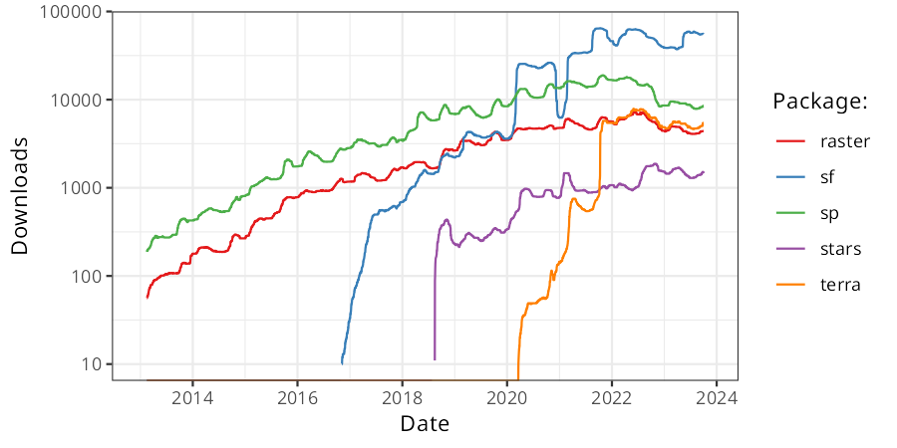
Downloads of selected R packages for working with geographic data from early 2013 to present.

